Slide 1

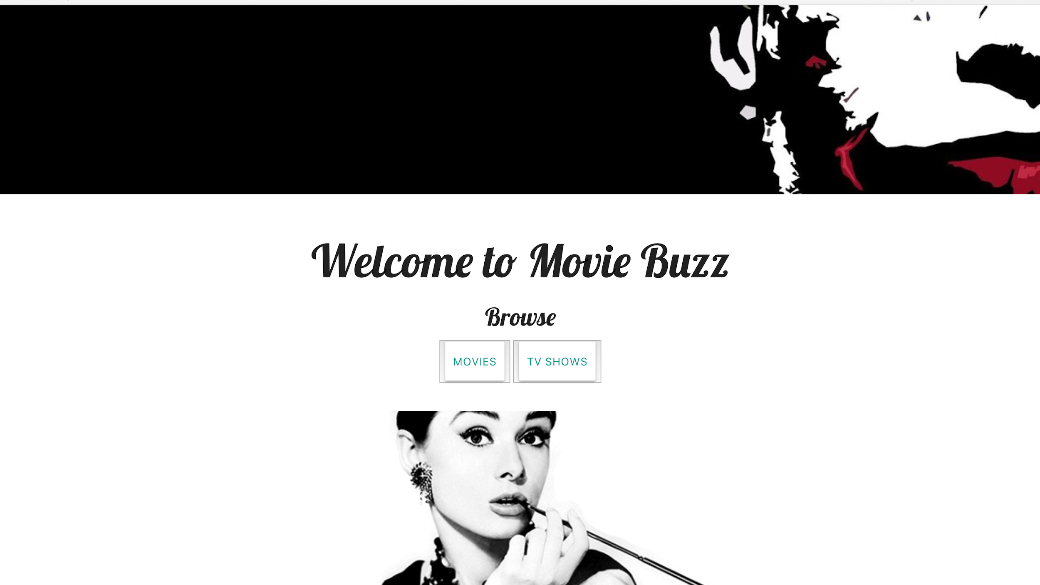
Movie
Buzz
By:
Nirupama,
Daniel and
Rawan

Slide 2
Concept

Slide 3
User Story
As a Movie Buff
I WANT to search for movies and shows and get information and be streamed in the leading apps (GooglePlay, Netflix, etc)
SO THAT I have good list of movies/shows is good to watch

Slide 4
Function
Provides a list of movies and tv shows to browse
Allows users to view:
General movie information
Ratings and reviews
A brief plot description
Apps that are streaming the selected movie and redirect to a specific app when clicked on

Slide 5
Home
Page
Notes:
Rawan

Slide 6
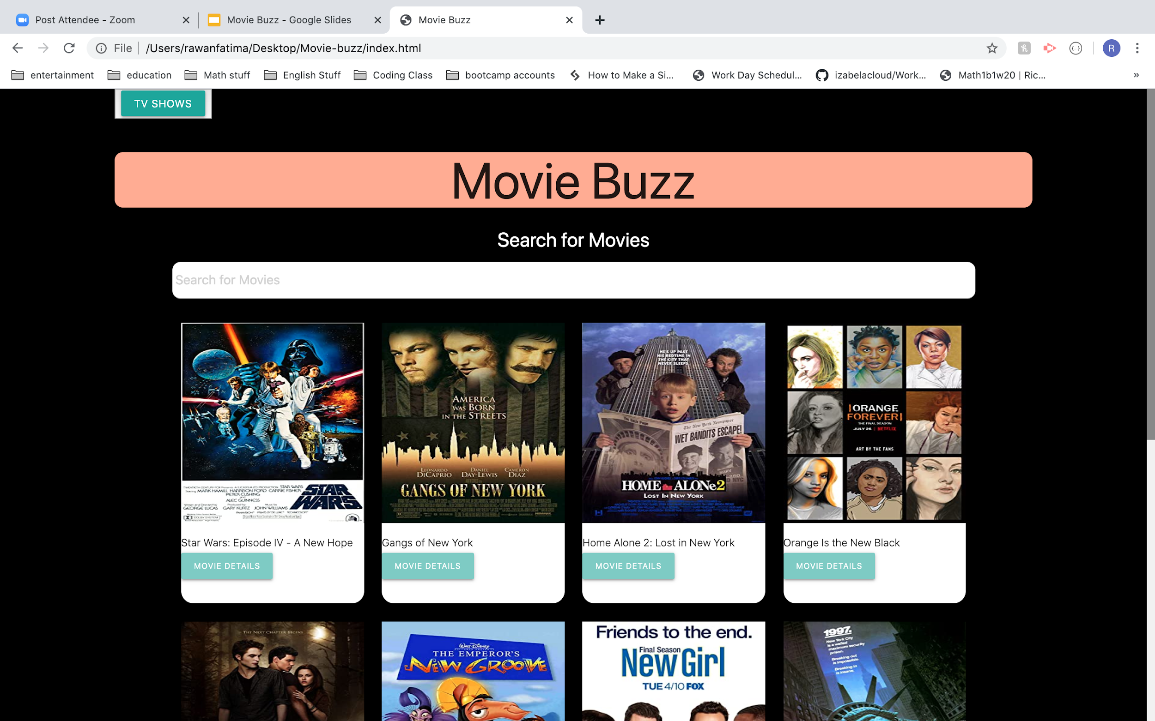
Movie Page
Notes:
Rawan

Slide 7
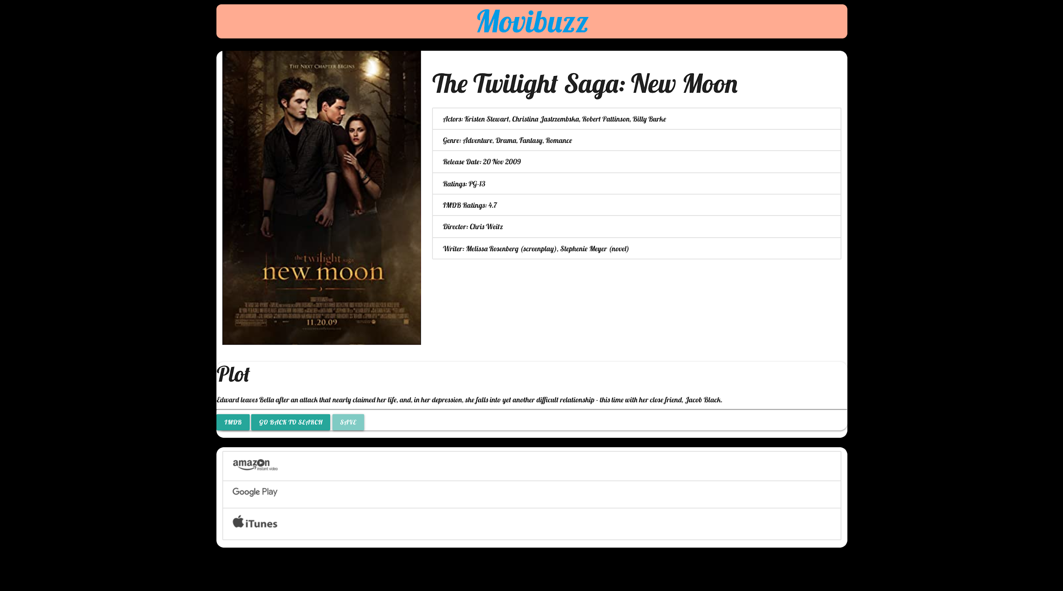

Slide 8
Compatibility
Compatible with both computers and phones
The use of media query allows the content to adjust to any screen size
Notes:
Nirupama

Slide 9
Process

Slide 10
Tasks Breakdown
Wireframe ------> Nirupama, Rawan and Daniel
Movie Page HTML/CSS/JS -----> Nirupama
Html/CSS Tv Page -----> Rawan, Daniel
Everyone together ------> contributed to the features to be included in the app and selected people finalized them

Slide 11
APIs Used
The OMDB
Utelly Rapid API
Episodate
Notes:
Nirupama

Slide 12
Technologies Used
HTML
CSS
Materialize
jQuery
Notes:
Nirupama

Slide 13
Movie
Buzz
By:
Nirupama,
Daniel and
Rawan

Slide 14
Concept

Slide 15
User Story
As a Movie Buff
I WANT to search for movies and shows and get information and be streamed in the leading apps (GooglePlay, Netflix, etc)
SO THAT I have good list of movies/shows is good to watch

Slide 16
Function
Provides a list of movies and tv shows to browse
Allows users to view:
General movie information
Ratings and reviews
A brief plot description
Apps that are streaming the selected movie and redirect to a specific app when clicked on

Slide 17
Home
Page
Notes:
Rawan

Slide 18
Movie Page
Notes:
Rawan

Slide 20
Compatibility
Compatible with both computers and phones
The use of media query allows the content to adjust to any screen size
Notes:
Nirupama

Slide 21
Process

Slide 22
Tasks Breakdown
Wireframe ------> Nirupama, Rawan and Daniel
Movie Page HTML/CSS/JS -----> Nirupama
Html/CSS Tv Page -----> Rawan, Daniel
Everyone together ------> contributed to the features to be included in the app and selected people finalized them

Slide 23
APIs Used
The OMDB
Utelly Rapid API
Episodate
Notes:
Nirupama

Slide 24
Technologies Used
HTML
CSS
Materialize
jQuery
Notes:
Nirupama

Slide 25
Challenges
Finding the right APIs for the app: OMDB, episodeate
Fetching the contents of the API and displaying it on the app was challenging.
Using Modals/jQuery Dialog instead of alerts.
Making sure that the dynamically generated cards were of the equal length
Given the functionality of the app, it was crucial to use API’s that were compatible with the vision behind the project and delivered related data

Slide 26
Directions for Future Development

Slide 27
Ways to Enhance the App:
New API can be incorporated which has the list of trending movies and that can be the movies default page.
Movies can be displayed according to their Genre when a word is searched

Slide 28
Work Together
Teamwork is key
Working together allows for one project to be reviewed by more than one pair of eyes which enhances functionality

Slide 29
Demo

Slide 30
Links
GitHub Repository:
https://github.com/ns8279/Movie-buzz
Deployed Link:
https://ns8279.github.io/Movie-buzz

Slide 31
Challenges
Finding the right APIs for the app: OMDB, episodeate
Fetching the contents of the API and displaying it on the app was challenging.
Using Modals/jQuery Dialog instead of alerts.
Making sure that the dynamically generated cards were of the equal length
Given the functionality of the app, it was crucial to use API’s that were compatible with the vision behind the project and delivered related data

Slide 32
Directions for Future Development

Slide 33
Ways to Enhance the App:
New API can be incorporated which has the list of trending movies and that can be the movies default page.
Movies can be displayed according to their Genre when a word is searched

Slide 34
Work Together
Teamwork is key
Working together allows for one project to be reviewed by more than one pair of eyes which enhances functionality

Slide 35
Demo

Slide 36
Links
GitHub Repository:
https://github.com/ns8279/Movie-buzz
Deployed Link:
https://ns8279.github.io/Movie-buzz

